Slide 1

B18 Lesson 6
Bishop Stopford School
faith | justice | responsibility | truth | compassion
ONLINE LEARNING
Learning Objectives
Retrieval
Acquire
Action
Review
Dig Deeper

Slide 2
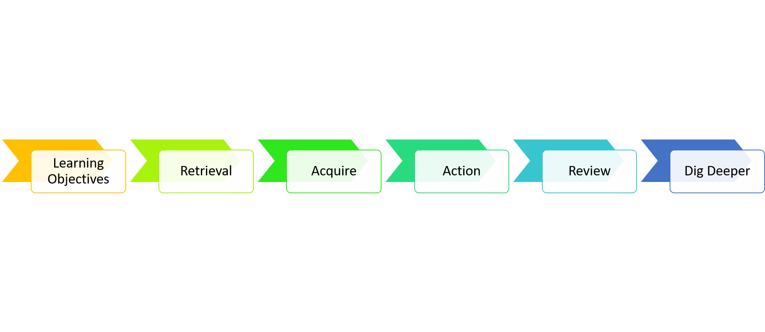
Trophic Levels and Biomass
Learning Objectives
1)Describe what is meant by the term ‘trophic level’
2)Interpret and construct pyramids of biomass
3)Explain why the biomass reduces at each stage of the food chain

Slide 3
Starter – KS3 Reminder
Oak tree → Caterpillar → Blue Tit → Sparrow Hawk
From the above food chain name
1)The producer
2)The primary consumer
3)A herbivore
4)A carnivore
5)The apex predator

Slide 4
Starter – ANSWERS
Oak tree → Caterpillar → Blue Tit → Sparrow Hawk
1)The producer
Oak tree – producers make their own food via photosynthesis
2)The primary consumer
Caterpillar – the first organism that obtains food by consuming another organism
3)A herbivore
Caterpillar – consumes only producers (plants)
4)A carnivore
Sparrow hawk /blue tit – eats other consumers (animals)
5)The apex predator
Sparrow hawk - Apex predators are carnivores with no predators

Slide 5


Watch video 1
You can watch this video as many times as you want to
https://youtu.be/AFC5LQ3KnvU

Slide 6
Watch video 2
You can watch this video as many times as you want to
https://youtu.be/sgh1OWm0oTQ

Slide 7
Key Notes – Food chains
The dry mass of an organism is called its biomass. Green plants transfer the light energy to chemical energy during photosynthesis. This energy is stored in the substances that make up the cells of the plants – the biomass. This biomass then gets passed along food chains as one organism consumes another.
A simple food chain is:
algae → mosquito larvae → dragon fly larvae → perch
All the food chains in an ecosystem can be added together to make a food web. The stages in a food chain or web are called trophic levels. The arrows show the transfer of biomass and the energy contained within it from one trophic level to another.

Slide 8
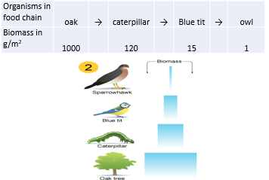
Key Notes – Pyramids of Biomass
In any ecosystem the biomass present at each level of a food chain can be shown as a pyramid of biomass
The amount of biomass (and the energy stored in it) gets less as you go along a food chain. This is because
1)Not all the food can be digested and absorbed – some is lost as faeces
2)Some of is used in respiration to release energy. This energy is used for living processes (e.g. movement, maintaining body temp.)
3)Biomass is lost in waste products of metabolism (e.g. carbon dioxide, water, urea)

Slide 9
Task
Complete then self-assess the exam questions. Write a score, WWW/EBI.
https://bishopstopford.fireflycloud.net/science-2/school-closure-tasks/year-10-1/biology/triple/b18-biodiveristy-and-ecosystems

Slide 10

Review
Complete the following interactive kerboodle tasks to review the content of this lesson
https://www.kerboodle.com/app/courses/19899/modules/Resources/node/15829/page/1/content/154392,154457,168227

Slide 11
Dig deeper (optional)
A tree starts out as a tiny seed! Where does the biomass of the tree come from?

